Slide 1

System Design and Demonstrator of a SPU Power Generation Sub-System of a Space Tug for Space Debris Remediation Operations in Lower Earth Orbit (FYP III)
Project ID: I2136
PRESENTED BY:
Sajal Saeed (210340)
Abdullah Zahid (210341)
SUPERVISOR:
Prof. Dr. Ali Sarosh
Co-SUPERVISOR:
Dr. Akram Rashid

Slide 2
Presentation Overview
Introduction & Preamble
Objectives
Research Methodology
Literature Review & Problem Statement
Conceptual Model
Workflow Flowchart / Diagram
Mathematical Models
Solvers
PCU Stimulation
Achievements / Completed Tasks
Conclusion
Cost analysis
Reference

Slide 3
Introduction & Preamble
Dr. Ali Sarosh PI
From IAA-AHQ
Phase03 By IAA-EE
Phase01 By IAA-Mechatronics’
Team 03
Team 01
Team 02
H2Z
Satellite Power
COSPAR(UN)
Phase02 By PAF
Working
Design
Power Control Unit
NO
Space Debris
Remediation
Satellite Design
Power Generation
System
YES
Space Debris
Remediation
Robotic arm
Payload Software
Defined Radio
Power Distribution
System
Contract Award for
Satellite Design
& Development
SDR1 Paylaod
SDR2 Paylaod
Delivering of
Concept Design Model to PAF & COSPAR

Slide 4
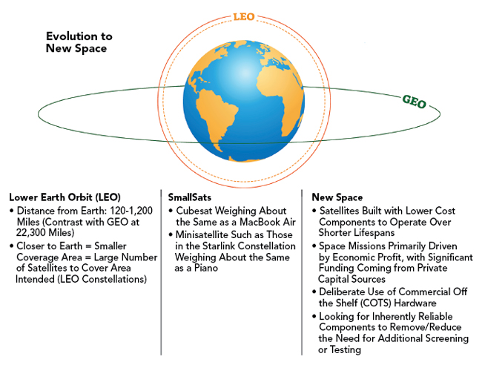
Introduction
Space Debris Remediation
Space debris from defunct satellites poses significant collision and communication-interference risks in Earth’s orbit.
Robotic-arm-based capture and deorbit methods, demonstrated by ClearSpace and Astroscale using precision grippers, offer an effective, low-fragmentation remediation technique.
Software Defined Radios (SDRs) provide flexible, reconfigurable communication links that adapt to dynamic orbital environments.
SDRs ensure robust command and data telemetry for debris-removal missions.

Slide 5
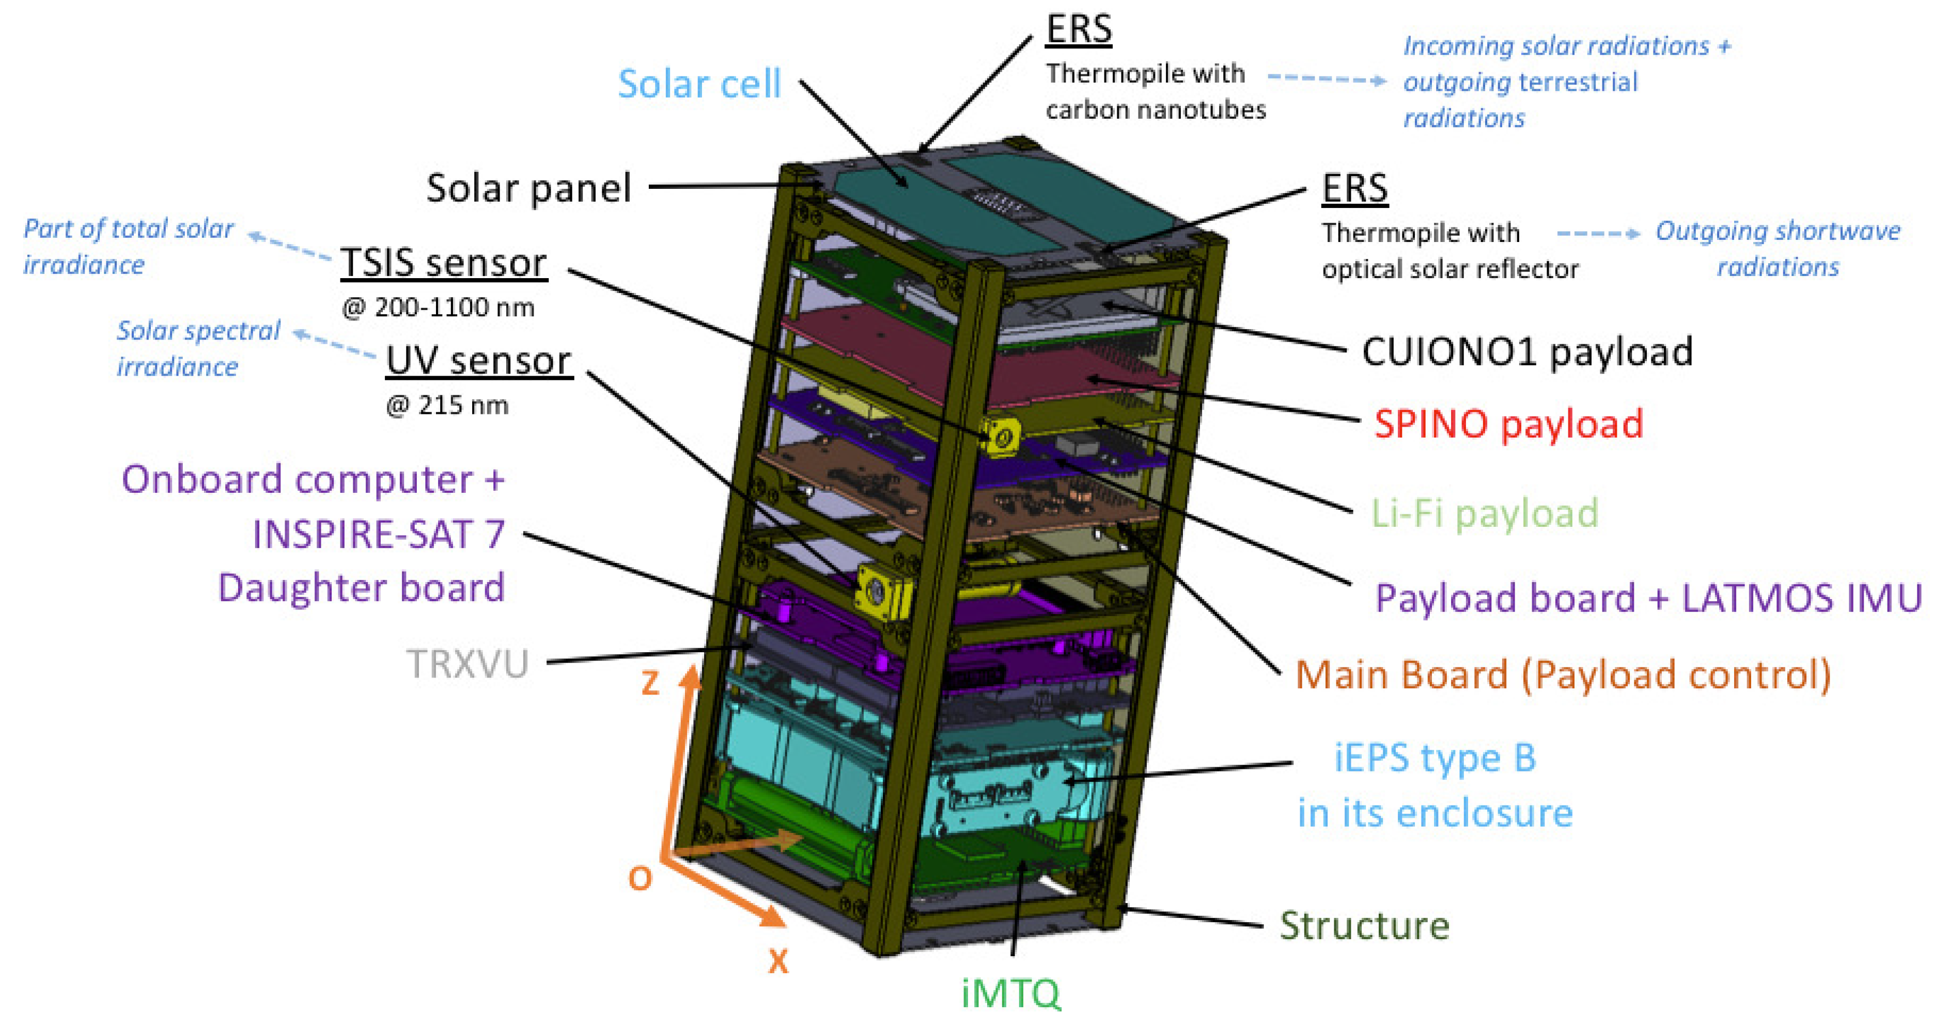
Introduction
What is Space Tug?
A space tug is a spacecraft designed to transport, reposition, or deorbit other satellites or payloads in space.
Space tugs can be robotic and equipped with tools like robotic arms, docking ports, or ion thrusters.
Why we using Space Tug?
To extend the life of aging satellites by repositioning or refuelling them.
To remove or deorbit defunct satellites, helping reduce space debris.
To support on-orbit servicing, inspection, or repairs of satellites.

Slide 6
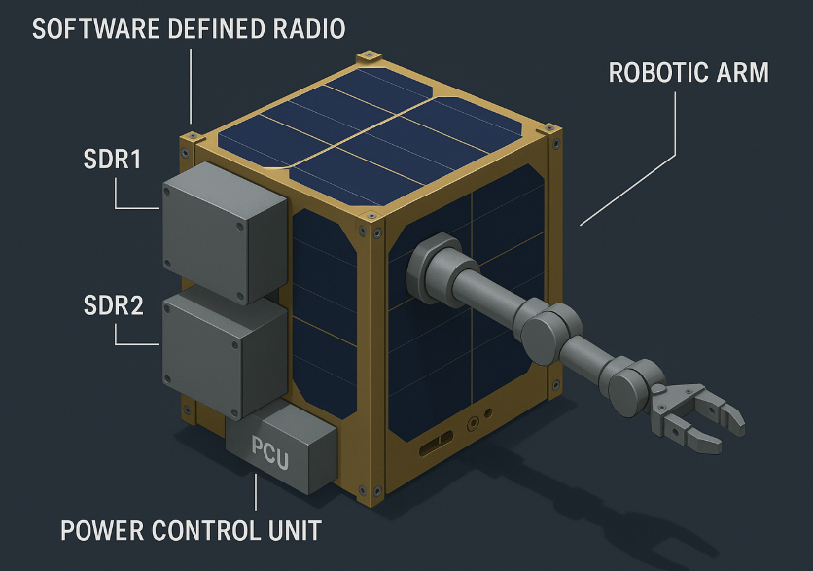
Introduction
How our Cubesat should be looks?
What is CubeSat?
A CubeSat is a type of miniaturized satellite for space research.
Typically, a single unit (1U) CubeSat measures 10x10x10 cm and weighs about 1 to 1.33 kg.
CubeSats are used for various missions, including Earth observation, communication, and technology demonstration.

Slide 7
Introduction
Our Contribution in this mission?
Power Generation Unit (Algorithm of this are in slide 18 & 21 )
Space Debris Remediation
Robotic Arm &
Camera
Power Storage Unit
(Algorithm of this is in slide 22)
Power Control Unit (A Microcontroller act as a control system for all the other units)
Power Distribution Unit
(Algorithm of this is in slide 23)
Software Defined Radio
Nano link &
TOTEM
Power Dissipation Unit
(Algorithm of this is in slide 24)

Slide 8
Objectives
Objectives:
Research and develop a Mathematical
Model for SDR 1 and SDR2.
Design solvers for SDR’s.
Simulate the design as per results.
Deliverable: A complete mathematical model for SDRs The design that support the space environments and unexpected situations face on space.

Slide 9
RESEARCH METHODOLOGY
PCU Solutions:
Working
design
Pass Fail
Efficiencies
Distribution
Parameters
Power Conditional Parameters
Literature
Review and Research
YES
Designing proposal
process
YES
Market Survey
PCU designing
Final Design Acceptance
Design Acceptance
NO
Mathematical
Model
NO
Baseline solution
Meet
Requirements
Solver Development
NO
Meet all parameters
YES
Design Surrogates
YES
Simulations
Testing of Solver

Slide 10
Satellite SDR &PCU Literature Review
Total Papers
`Textbooks References
Space Mission Analysis and Design by Wiley J. Larson
Elements of Spacecraft Design by Charles D. Brown
Principles of Spacecraft Control by Walter Fichter and Ramin T. Geshnizjani
“Dr. Yoshihiro Tsuruda from Teikyo University,” Introduction to CubeSat Power Control System
Dr. Yoshihiro Tsuruda’s lecture examines the impact of CubeSat Electrical Power System (EPS) design on satellite functionality in low Earth orbit, emphasizing core components like solar arrays (power generation), batteries (energy storage), and power control circuits (regulation/distribution).
The research underscores the critical role of Maximum Power Point Tracking (MPPT) circuits to maximize solar efficiency amid variable lighting and protection circuits to prevent overcurrent/overvoltage damage. Real-world CubeSat mission examples demonstrate challenges in balancing power supply-demand for sustained operational reliability.
SDR1
Technology
20
SDR2
Technology
10
PCU
System
30
Total paper
60

Slide 11
Satellite H2Z Literature Review
 | Reference | Problem Statement | Methodology | Key Finding | Challenges
SDR1 | Ali Sarosh, Shakir Hussein Ch. (NUST) | Efficient CubeSat solar array design considering efficiency and radiation damage | Reviews cell types, calculates power needs, analyzes radiation effects | Multi-junction cells offer high efficiency; radiation and coverslip thickness impact output | High costs, radiation degradation, precise sizing required
 | Shin-Ichiro Nishida & Satomi Kawamoto (2009) | Debris removal using small satellites | Swarms of small satellites with nets/robotic arms/tethers | Affordable and flexible approach for medium debris removal | Satellite configuration and propulsion requirements
 | Ali Sarosh (NUST) | Need for reliable power generation for robotic debris removal missions in LEO | Reviews solar cell evolution; compares component efficiency and damage fluence methods for sizing arrays; analyzes tethered tug dynamics | Multi-junction cells and optimized sizing improve mission power reliability; tethered tug enables safe debris removal | Radiation-induced degradation, sizing accuracy, managing tether dynamics, and vibration control
 | University of Southampton (DAMAGE model) | Simulating debris removal efficacy | Century-long LEO debris density modeling | Removing 5-10 large debris objects annually stabilizes growth | Minimal adverse effects from removal mission launches
SDR2 | JAXA (2022) | Autonomous collision avoidance in congested LEO | Onboard software for real-time risk assessment and maneuver execution | Demonstrated effectiveness in operational spacecraft | Integration of sensor data with predictive algorithms
 | M. Chan & D. Sinclair | Autonomous collision prediction for LEO satellites | Machine learning-based risk assessment algorithms | Reduced ground control dependency through real-time decision-making | Algorithm adaptability to dynamic debris environments
 | R. Gupta & P. Singh | CubeSat debris detection capabilities | AI-driven computer vision for autonomous detection | Improved situational awareness for small satellites | Limited communication window constraints

Slide 12
Satellite H2Z Literature Review
 | Reference | Problem Statement | Methodology | Key Finding | Challenges
PCU | D. Hernandez & M. Lopez | Power efficiency in CubeSat solar arrays | Hardware-software integrated MPPT algorithm | 15-20% power extraction improvement under variable illumination | Implementation challenges in miniaturized systems
 | Y. Tsuruda & K. Saito | Scalable power management for CubeSats | Modular power distribution unit design | Fault-tolerant architecture supporting diverse mission profiles | Thermal management in compact designs
 | J. Smith & A. Patel | Long-duration CubeSat operation | Coordinated thermal/power management system | 30% battery life extension in simulation models | System integration complexity in harsh environments
SDR1, SDR2 and PCU of H2Z | H2Z (Own project) | Increasing space debris in LEO threatens satellites and effective communication, especially for small satellites. | Designed a modular space tug with debris capture systems and integrated Software Defined Radio (SDR) for improved communication, using literature review, trade-off studies, and subsystem integration. | Demonstrated feasibility of a modular space tug with advanced debris capture and SDR-based communication to enhance orbital sustainability. | Complex subsystem integration, deployment reliability, mass/power constraints, and legal/regulatory hurdles for active debris removal.

Slide 13
Problem Statement
The rapid expansion of space activities has created two critical threats to the sustainability of space operations: the alarming increase in space debris and the overcrowding of satellite communication frequencies. Currently, there are over 40,000 trackable pieces of debris orbiting Earth, along with tens of millions of smaller, untrackable fragments. This growing cloud of debris significantly raises the risk of collisions, endangering operational satellites, space stations, and future missions. At the same time, the S-band used by more than 70% of satellites in LEO, has become increasingly congested, complicating communications and intensifying competition for limited frequency resources. Together, these issues not only escalate operational risks and costs but also threaten the long-term viability and safety of space infrastructure and ongoing exploration efforts.

Slide 14
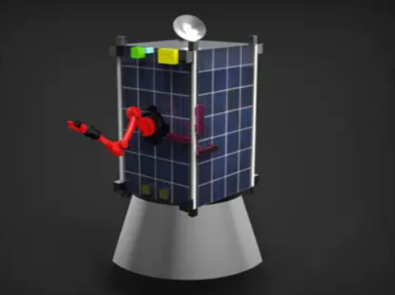
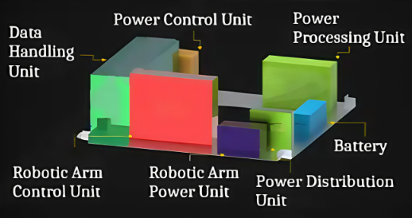
CONCEPTUAL MODEL of Satellite SDR
Communication
Device SDR2
SDR1
Robotic Arm
Solar Panel
Propulsion
Fig.(1) SDR1 Conceptual 3d design
Fig.(2) Whole system conceptual 3d design working by and on around Power Control Unit

Slide 15
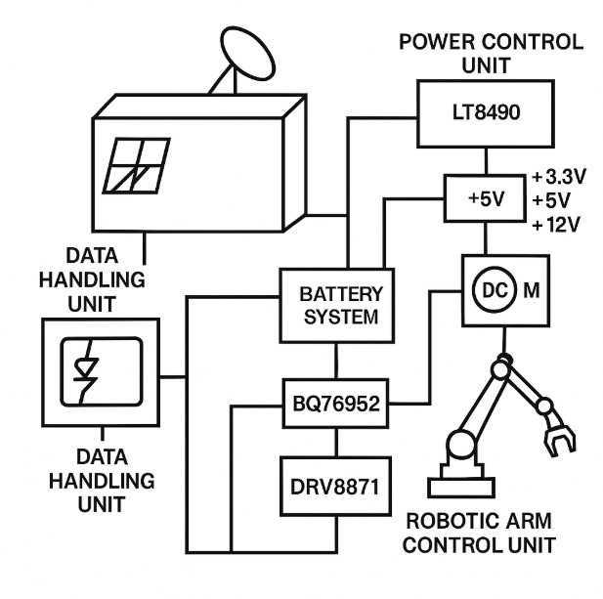
CONCEPTUAL MODEL of Satellite SDR
A complete representation of satellite SDR along with their subsystems and work process of the components using in this system. From satellite as communication device to Robotic arm as an output working as on input given from a Power Control Unit which I designed on specific programing.
Solar Panel
Propulsion

Slide 16
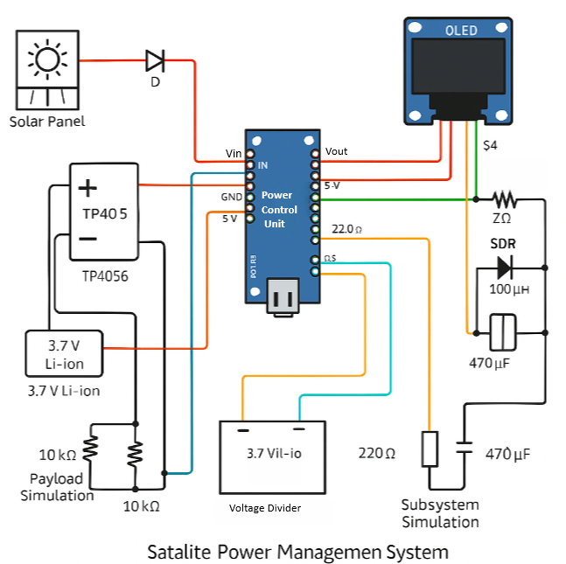
CONCEPTUAL MODEL of Satellite PCU
Azur solar cell input with a blocking diode prevents reverse current, feeding power to a TP4056 module for charging a 3.7V Li-ion battery. ESP32 PCU monitors battery voltage via a voltage divider and manages power distribution to payloads/subsystems . Power regulation uses resistors (22Ω/220Ω) and capacitors to simulate load control and current measurement . Soft Diode Rectifier (SDR) provides backup power conditioning and protection alongside primary regulation . OLED display (I²C interface) outputs real-time status updates for voltage, current, and system health .

Slide 17
Satellite SDR2 Market Survey
Software Defined Radio(SDR2):
Sdr 2 modules were selected through SWAPC metric system.
Module Name | Size (cm) | Weight (g) | Power (W) | Cost (USD) | Extra Features | Score (1-10)
TOTEM | 8 x 8 x 2 | 150 | 2.5 | 3,500 | - | 9
NANOlink-base-2 | 9 x 9.6 x 2 | 180 | 3 | 4,000 | - | 8.39
NANOlink-boost-2 | 9 x 9.6 x 2 | 190 | 4 | 4,500 | - | 8.09
NANOlink-boost-dp-2 | 9 x 9.6 x 2.5 | 210 | 5 | 5,500 | Dual polarization capability | 8.44
SDR-1001 | 8 x 8 x 3 | 170 | 4 | 3,500 | - | 8.36
SWIFT SLX | 9 x 9 x 3 | 220 | 6 | 7,500 | S and L band support | 7.79
XLink - X | 10 x 10 x 3 | 220 | 8 | 7,000 | Higher data rate | 7.4

Slide 18
Satellite SDR2 SWAPC Logic
Cost Score (1-2) min 3500 and max 10,000
Weight Score (1-2) min 150g and max 250
Size Score (1-2) min 8x8x2 and max 10x10x4
Power Score (1-2) min 2.5 and max 10
Feature Score (1-2)
Module Name | Size (cm) | Weight (g) | Power (W) | Cost (USD) | Extra Features | Score (1-10)
TOTEM | 8 x 8 x 2 | 150 | 2.5 | 3,500 | - | 9
NANOlink-base-2 | 9 x 9.6 x 2 | 180 | 3 | 4,000 | - | 8.39
NANOlink-boost-2 | 9 x 9.6 x 2 | 190 | 4 | 4,500 | - | 8.09
NANOlink-boost-dp-2 | 9 x 9.6 x 2.5 | 210 | 5 | 5,500 | Dual polarization capability | 8.44
SDR-1001 | 8 x 8 x 3 | 170 | 4 | 3,500 | - | 8.36
SWIFT SLX | 9 x 9 x 3 | 220 | 6 | 7,500 | S and L band support | 7.79
XLink - X | 10 x 10 x 3 | 220 | 8 | 7,000 | Higher data rate | 7.4

Slide 19
Power Budget of 1500U Satellite
Power Budget
Subsystem | Sunlight (60min) |  | Eclipse (35min)
 | Peak Power (50 min) | nominal power(10min) | Non-Transmission Mode (25min) | Transmission Mode(10min)
ADCS | 70 | 61 | 63 | 63
TCS | 0 | 0 | 20 | 20
TTCS | 80 | 80 | 80 | 80
EPS | 172 | 150 | 65 | 75
CDHS | 20 | 20 | 20 | 20
Propulsion | 80 | 40 | 40 | 40
GNC | 25 | 20.5 | 20.5 | 20.5
Platform Total | 447 | 371.5 | 308.5 | 318.5
TOTEM TX | 5.50 | 5.5 | 0 | 5.5
TOTEM RX | 2.20 | 2.2 | 2.2 | 2.2
NANOlink TX (Boost) | 18.70 | 9.35 | 0 | 0
NANOlink RX (Boost) | 1.79 | 1.793 | 1.793 | 1.793
SDR2 Total | 28.19 | 18.84 | 3.99 | 9.49
Robotic Arm | 30 | - | - | -
Camera | 40 | 16.67 | 16.67 | 28.33
Battery Charging Requirement | 120 | 217 | - | -
Harness Losses | 5.8 | 5.7 | 2.9 | 0.34
Total Power Required | 699.19 | 648.55 | 336.05 | 366.16
Average Power Output From Solar Array | 699.19 | 669.085 |  | -
Margin (%) | 8.68 | 8.68 | - | -
Power Required From Battery | - | - | 160.86 | 160.86
Battery DOD (%) | - | - | 80 | 80
Average Margin (%) | 20 | 30 | - | -

Slide 20
Power Budget of 1U Satellite
Power Budget
Subsystem | Sunlight (60min) |  | Eclipse (35min)
 | Peak Power (50 min) | nominal power(10min) | Non-Transmission Mode (25min) | Transmission Mode(10min)
ADCS | 0.7 | 0.61 | 0.63 | 0.63
TCS | 0 | 0 | 0.2 | 0.2
TTCS | 0.8 | 0.8 | 0.8 | 0.8
EPS | 1.72 | 1.5 | 0.65 | 0.65
CDHS | 0.2 | 0.2 | 0.2 | 0.2
Propulsion | 0.8 | 0.4 | 0.4 | 0.4
GNC | 0.25 | 0.2 | 0.2 | 0.2
Platform Total | 4.47 | 3.71 | 3.08 | 3.08
TOTEM TX | 0.06 | 0.055 | 0 | 0.055
TOTEM RX | 0.02 | 0.022 | 0.022 | 0.022
NANOlink TX (Boost) | 0.19 | 0.093 | 0 | 0
NANOlink RX (Boost) | 0.02 | 0.0179 | 0.017 | 0.017
SDR2 Total | 0.28 | 0.19 | 0.04 | 0.09
Robotic Arm | 0.3 | - | - | -
Camera | 0.4 | 0.17 | 0.16 | 0.28
Battery Charging Requirement | 1.2 | 2.17 | - | -
Harness Losses | 0.58 | 0.57 | 0.029 | 0.0003
Total Power Required | 7.51 | 6.99 | 3.35 | 3.55
Average Power Output From Solar Array | 6.69 | 6.69 |  | -
Margin (%) | 8.68 | 8.68 | - | -
Power Required From Battery | - | - | 1.60 | 1.60
Battery DOD (%) | - | - | 80 | 80
Average Margin (%) | 20 | 30 | - | -

Slide 21
Satellite Work Flow Chat
Power Conditioning Unit
Power Distribution Unit
DC/AC Inverters:
Propulsion: 120V AC, 200–500W (Full-Bridge).
Payload: 28V→12V AC, 50W (Half-Bridge Resonant).
Motors: 28V→48V AC, 100–300W (Three-Phase PWM)
28V Main Bus
ADCS: 70W, 2.5A
Propulsion: 80W, 2.86A
Arm: 30W, 1.07A
Camera: 40W, 1.43A (sun), 1.01A (eclipse) = 28.33W, 1.014A (eclipse)
Solar Array (GaAs):
Sunlight: 708.27W, 81.68V, 8.674A, 534 cells
Eclipse: 335.6W, 48.4V, 6.936A, 256 cells
LCL sizing:
I = 1.25×Imax-load
Thermal:1.07°C/
Protection:
Dual PDU cross-strapped LCLs15
Fault:
LCL<100µs trips.
Overtemperature:
105°C auto-shutdown
EMI/EMC:
MIL-STD-461G
12V Bus
TT&C: 80W, 6.67A
TCS: 20W, 1.67A (eclipse)
Solar Array Regulators:
Vin= 24–50V
MPPT >98.8%
Vout=28V ±5% out
3.3V Bus
Digital: 9W
µC: 6W
Battery Charge and Discharge Regulator:
BCR: Vin=24-50 from solar
Vout=18-24V
Icharge=18A
BDR: Pdischarge=201W
Over current Protection=250A
5V Bus
CDHS: 20W, 4A
NANOLink: 1.793W, 0.36A
TOTEM: 2.2W, 0.44A

Slide 22
Mathematical Model
for Satellite SDR’s
and PCU

Slide 23
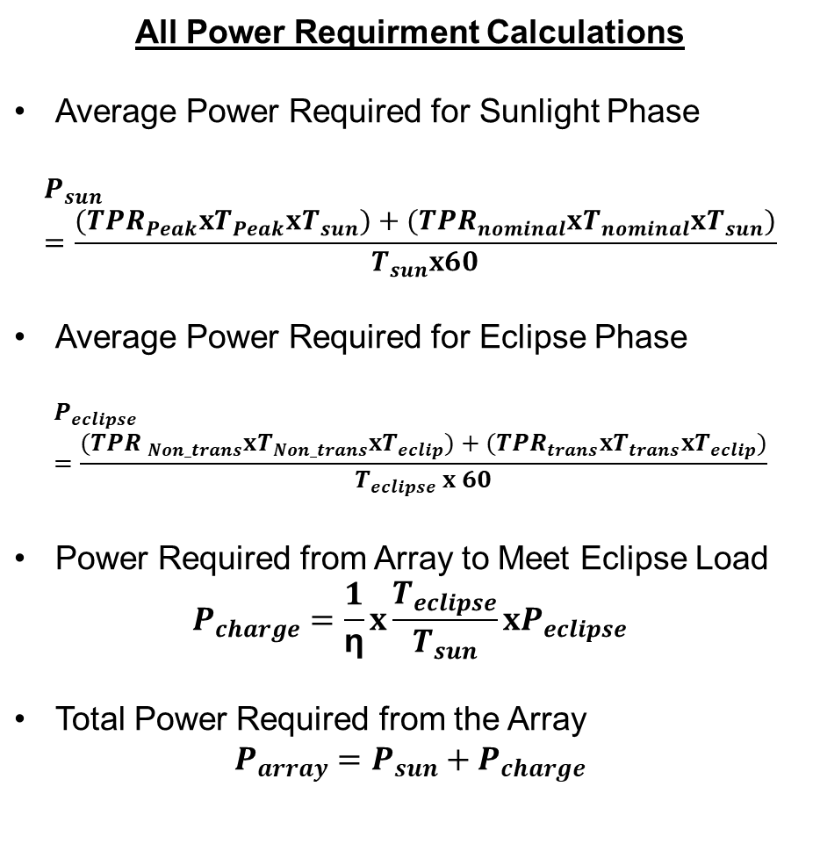
Mathematical Model for Satellite SDR’s
All Power Requirment Calculations Average Power Required for Sunlight Phase $$P_{sun}=\frac{({TPR}_{Peak}xT_{Peak}xT_{sun})+({TPR}_{nominal}xT_{nominal}xT_{sun})}{T_{sun}x60}$$ Average Power Required for Eclipse Phase $$P_{eclipse}=\frac{({TPR }_{Non_trans}xT_{Non_trans}xT_{eclip})+({TPR}_{trans}xT_{trans}xT_{eclip})}{T_{eclipse} x 60}$$ Power Required from Array to Meet Eclipse Load $$P_{charge}=\frac{1}{\text{η}}x\frac{T_{eclipse}}{T_{sun}}xP_{eclipse}$$ Total Power Required from the Array $$P_{array}=P_{sun}+P_{charge}$$
Symbol | Definition
Psun | Average Power Required During Sunlight Phase
Peclipse | Average Power Required During Eclipse Phase
T | Orbit Period
Tsun | Time in Sunlight
Teclipse | Time in Eclipse
TPR | Total Power Required
Pcharge | Power Required from Solar Array to Charge Battery for Eclipse Load
Parray | Total Power Required from Solar Array

Slide 24
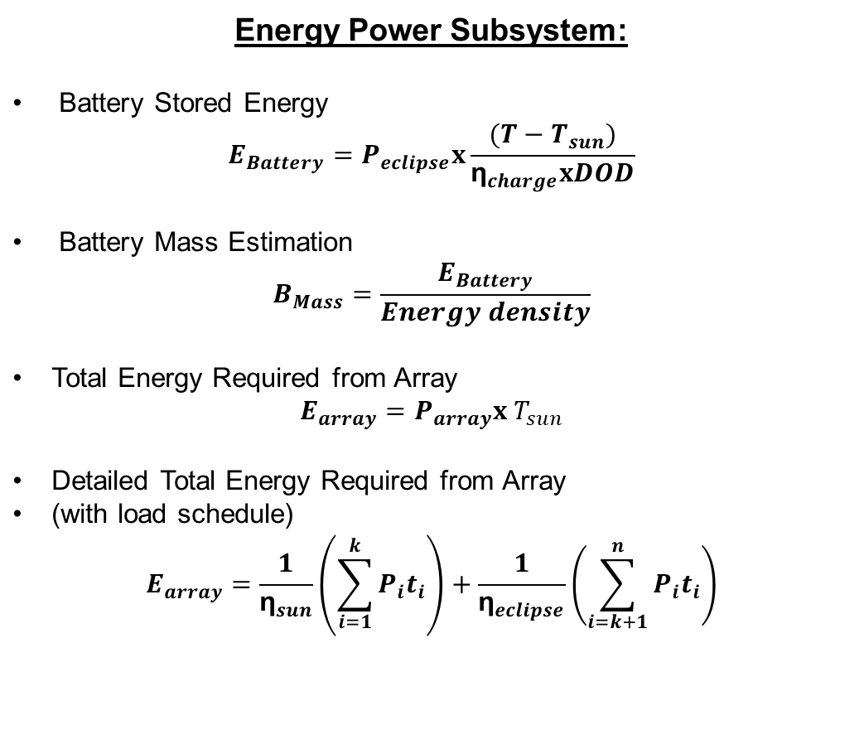
Mathematical Model for Satellite SDR’s
Symbol | Definition
EB | Battery Stored Energy
ηcharge | Battery Charging Efficiency
DOD | Depth of Discharge of Battery
Earray | Total Energy Required from Solar Array
Pi | Power consumption by the i-th subsystem or payload
ti | Time duration of operation for the i-th subsystem or payload
ηsun | Efficiency during sunlight phase
ηeclipse | Efficiency during eclipse phase
Energy Power Subsystem: Battery Stored Energy $$E_{Battery}=P_{eclipse}x\frac{{(T−T}_{sun})}{{\text{η}}_{charge}xDOD}$$ Battery Mass Estimation $$B_{Mass}=\frac{E_{Battery}}{Energy density}$$ Total Energy Required from Array $$E_{array}=P_{array}x{ T}_{sun}$$ Detailed Total Energy Required from Array (with load schedule) $$E_{array}=\frac{1}{{\text{η}}_{sun}}\left(\sum_{i=1}^{k}{P_{i}t_{i}}\right)+\frac{1}{{\text{η}}_{eclipse}}\left(\sum_{i=k+1}^{n}{P_{i}t_{i}}\right)$$

Slide 25
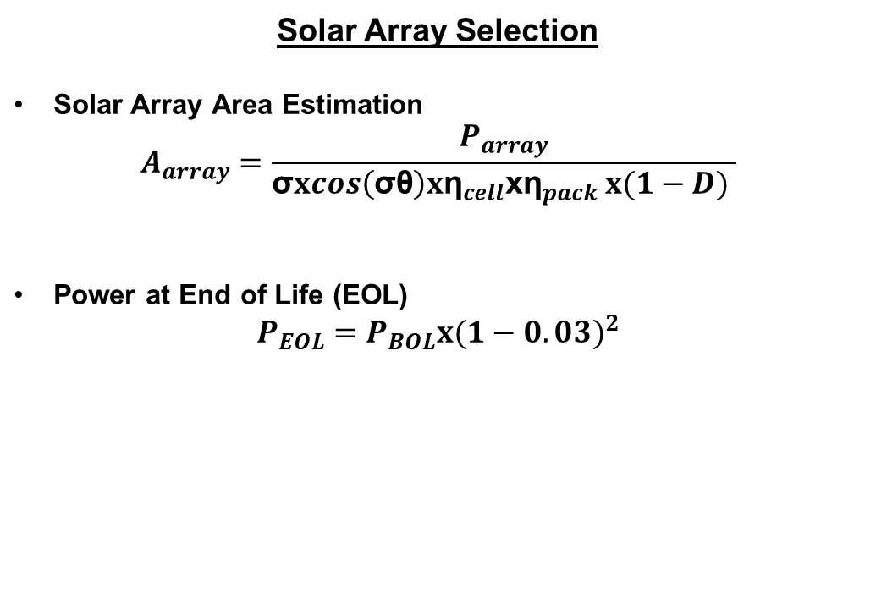
Mathematical Model for Satellite SDR’s
Symbol | Definition
Aarray | Required Solar Array Area
S0 | Solar Flux (~1367 to 1400 W/m²)
cosSθ | Cosine of the Solar Array Pointing Error
ηcell | Solar Cell Efficiency (e.g., GaAs)
ηpack | Cell Packing Efficiency
D | Solar Array Degradation Factor
Solar Array Selection Solar Array Area Estimation $$A_{array}=\frac{P_{array}}{\text{σ}xcos\left(\text{σθ}\right)x{\text{η}}_{cell}{\text{x}\text{η}}_{pack} x(1−D) }$$ Power at End of Life (EOL) $$P_{EOL}=P_{BOL}x{(1−0.03)}^{2}$$

Slide 26
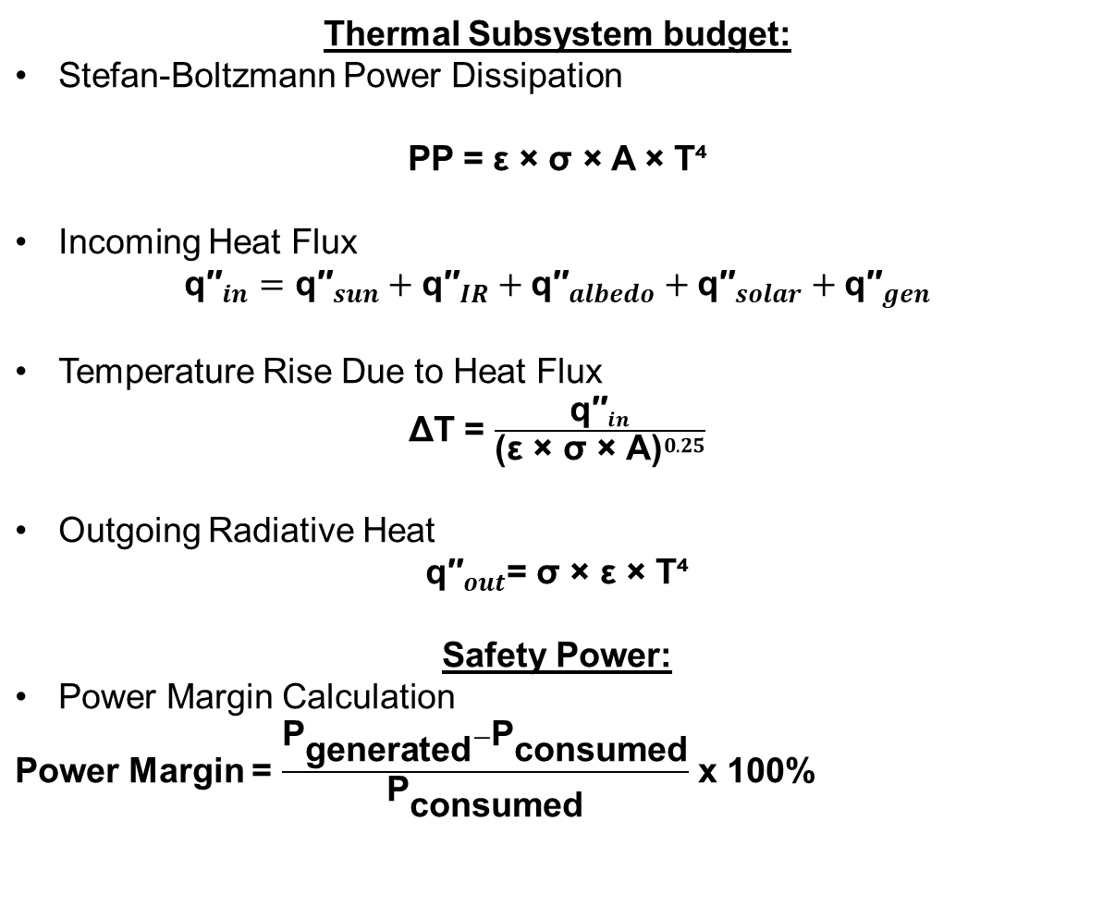
Mathematical Model for Satellite SDR’s
Symbol | Definition
PP | Power Dissipation
ϵ | Emissivity of surface
σ | Stefan-Boltzmann Constant (5.67 × 10⁻⁸ W/m²K⁴)
A | Radiative Surface Area
T (thermal) | Temperature in Kelvin (used in Stefan-Boltzmann law)
q″in | Incoming Heat Flux (W/m²)
q″out | Outgoing Radiative Heat Flux (W/m²)
ΔT | Temperature rise due to incoming heat flux
PBOL | Power at Beginning of Life of Solar Array
PEOL | Power at End of Life of Solar Array
Ld | Degradation Factor per year
Pdischarge | Power output from the battery during eclipse, accounting for discharge efficiency
PDU | Power Distribution Unit
PCU | Power Conditioning Unit
BCR | Battery Charge Regulator
BDR | Battery Discharge Regulator
SAR | Solar Array Regulator
Thermal Subsystem budget: Stefan-Boltzmann Power Dissipation PP = ε × σ × A × T⁴ Incoming Heat Flux $${\text{q}\text{′′}}_{in}={\text{q}\text{′′}}_{sun}+{\text{q}\text{′′}}_{IR}+{\text{q}\text{′′}}_{albedo}+{\text{q}\text{′′}}_{solar}+{\text{q}\text{′′}}_{gen}$$ Temperature Rise Due to Heat Flux ΔT = $\frac{{\text{q}\text{′′}}_{in}}{{\text{(}\text{ε} \text{×} \text{σ} \text{×} \text{A}\text{)}}^{0.25}}$ Outgoing Radiative Heat ${\text{q}\text{′′}}_{out}$= σ × ε × T⁴ Safety Power: Power Margin Calculation Power Margin = $\frac{{\text{P}}_{\text{generated}}−{\text{P}}_{\text{consumed}}}{{\text{P}}_{\text{consumed}}}$ x 100%

Slide 27
Satellite Program on basis of Mathematical model
Inputs of satellite: self.power_conversion_efficiency = {'PDU Efficiency': 0.98, 'PCU Efficiency': 0.97, 'BDR Efficiency': 0.89,'BCR Efficiency': 0.91}
self.solar_cell_efficiency ={'Gallium Arsenide Efficiency': {'Temp = 0': 0.338, # 33.8% at 0°C,'Temp = 200': 0.179 ,# 17.9% at 200°C},'Solar Cell Packing':{'n_pack’: 0.9}}
self.power_management_efficiency = {'Battery Charging Efficiency': 0.93, 'Battery Discharge Regulation Efficiency': 0.91, 'Array Degradation Factor': 0.03 # 3% per year}
# Design Constraints self.sunlight_phase_duration = 1.029,self.eclipse_phase_duration = 0.6043, self.orbit_period = 1.633, self.mass = 500,
self.orbit_name = ['Sun-Synchronous Orbit', 'A-Synchronous Orbit', 'Inclined Orbit']
self.orbit_parameters ={'SSO':{'Altitude': '500-700km','Eccentricity': 0,'Average Orbit': 95,'RAAN': 48.0589, 'Omega': 0,'Drag Area': 3.0,'Drag Area to Mass Ratio': 0.00061074,'Area Exposed to Sun': 6.66,'Solar Area to Mass Ratio': 0.01355, 'Drag Coefficient': 2.2,'Mass': 500}}
self.user_requirements={'LTDN':'10:30 AM','Beta Angle Variation':'-83.573° to 83.573°','Illumination Duration Ratio':'75.4%'}
# Constants self.solar_flux = 1367 self.stefan_boltzmann = 5.67e-8 self.battery_energy_density = 80 self.depth_of_discharge = 0.8

Slide 28
Satellite SDR Solver
This code solves the requirements of power, SSO changing phase power requirements, Power margin needed, Efficiency of components.
This design code have two classes of:
Config 1: The angle Beta will be the input from the user which converting the output of the designed code as aspecting the angle as input.
Config 2: The Power Budget can be alter by the input on the orbit period as well designed code can give you output on both SSO and NSSO.

Slide 29
Satellite SDR Solver
The solver algorithms to extract the needing solution:
Solver 1: Power Budget:- Sunlit and Eclipse power and charging requirements.
Solver 2: Sizing:- Solar array and Battery sizing, capacity requirements.
Solver 3: Power Dissipation Budget:-Calculate total power dissipation for all subsystems.
Solver 4:Thermal Analysis:- Calculate thermal dissipation using Stefan-Boltzmann law
Solver 5:Power Margin and Degradation:-Calculate power margin and degradation over time.
Solver 6:Power curve and load curve graphs:-Generate power and load curves, battery life, and power margin graphs.

Slide 30
Satellite SDR Solver Pseudo Code
BEGIN Satellite_SDR_Solver
1. Calculate sunlit and eclipse energy:
E_gen = P_solar * T_sunlit
E_req = P_total * (T_sunlit + T_eclipse)
2. Size solar and battery:
Battery_capacity = E_req * T_eclipse / (T_sunlit + T_eclipse)
Solar_power_needed = E_req / T_sunlit
3. Total power dissipation:
P_dissipation = SUM(P_each_subsystem)
4. Thermal analysis:
T = ((P_dissipation) / (ε * σ * A)) ^ 0.25
5. Power margin and degradation: E_gen_degraded = E_gen * (1 - d_rate)^years Margin = E_gen_degraded - E_req 6. Generate power/load curves: FOR time in mission Load[time] = SUM(loads) Power[time] = E_gen * (1 - d_rate)^(time/12) Battery[time] = computeBattery(...) END FOR END Satellite_SDR_Solver

Slide 31
Satellite SDR Solver Result
Solver 5
Solver 6
Solver 3
Solver 4
Solver 1
Solver 2
Total power dissipation through the subsystems of the cubesat at the given period of cycle.
W/h dissipation
In celius the temperature effect on cubesat.
Power Budget
Calculation:
Power required at Sunlit and at Eclipse.
Total power required from solar array
According to the solar 1 output the sizing of solar and capacitance of battery.
The thermal analysis of solar array.
q_out thermal dissipation through the solar.
The power is to be produced at some margin.
Power margin%
Per year degradation of the component in the cubesat.
It’s the power budget of 4years explained by the using of graph. Along with power margin, load curve and battery life trough out the year.

Slide 32
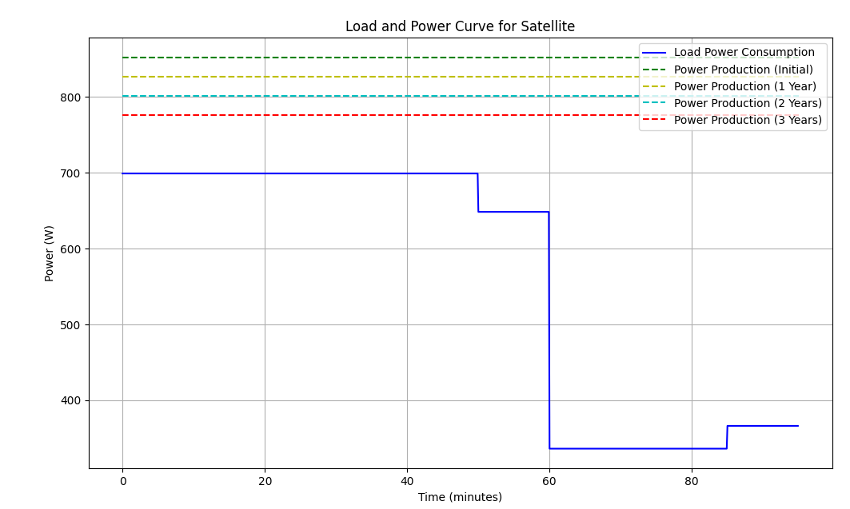
Satellite Solver Load and Power Budget
50mins
At peak power Sunlit load
25mins
Non-Transmission mode eclipse load
10mins
Nomimnal power Sunlit load
10mins
Transmission mode eclipse
load

Slide 33
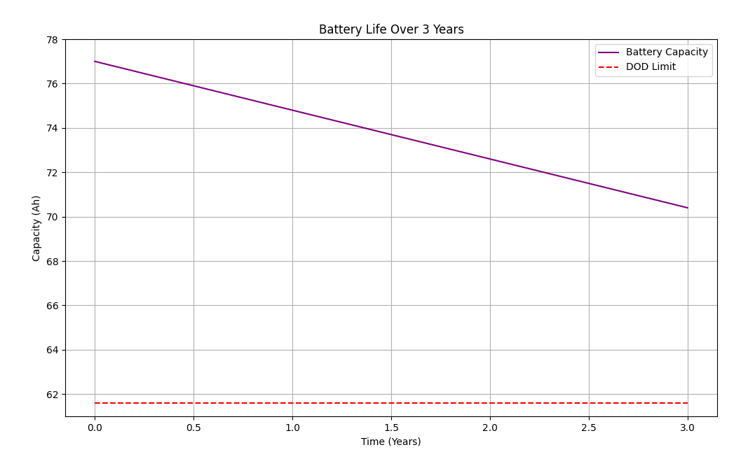
Satellite Solver Showing Battery Life
Battery Capacity
Over 3 years
Depth Of Discharge of Battery

Slide 34
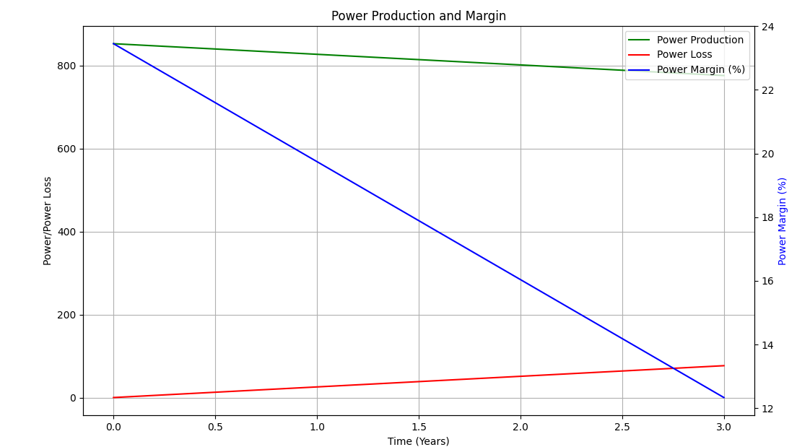
Satellite Solver Power Margin
Power Production
Of 3 years
Power Margin over 3 years
Power Loss of 3 years

Slide 35
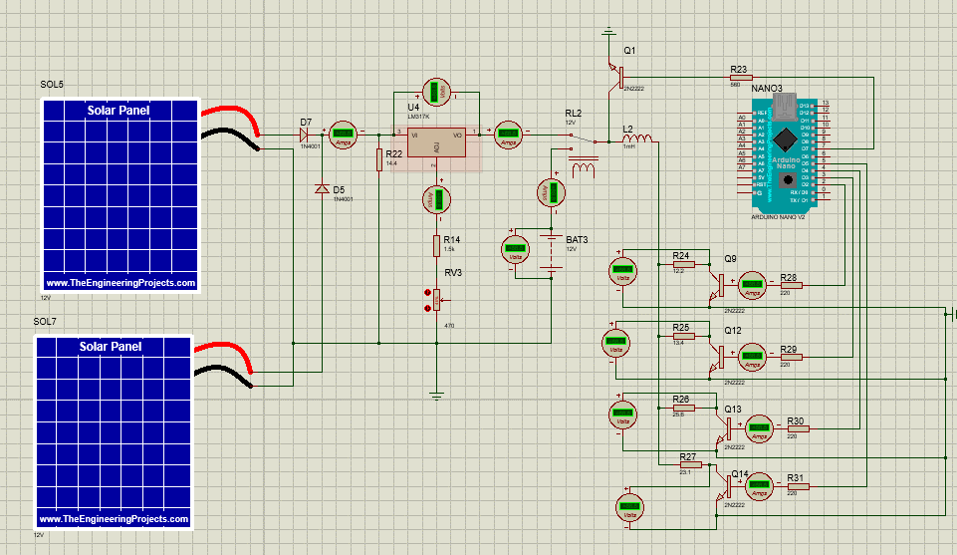
Satellite PCU Simulation

Slide 36
Achievements/Completed Tasks
Timeline | Milestone | Deliverable | Status
01/March-01/April | Completed Research on Space Debris Remediation | Review and analysis of 30 research papers focused on SDR1 technology for satellite SDR systems. | Competed
01/April-01/May | Developed Mathematical Model for SDR | A validated mathematical model applied to various space debris remediation cases. | Competed
01/May-01/June | SWAPC Score & SDR Component Design | A finalized SWAPC Score with a cost-effective SDR subsystem design meeting satellite requirements. | Competed

Slide 37
Achievements/Completed Tasks
Timeline | Milestone | Deliverable | Status
15/September-15/October | Completed Research on Space Debris Remediation | Review and analysis of 10 research materials focused on SDR2 technology for satellite SDR2 systems. | Competed
15/October-15/November | Developed Mathematical Model for SDR2 | A validated mathematical model applied to various space debris remediation cases. | Competed
15/November-15/December | SWAPC Score & SDR2 Component Design | A finalized SWAPC Score with a cost-effective SDR2 subsystem design meeting satellite requirements. | Competed

Slide 38
Achievements/Completed Tasks
Timeline | Milestone | Deliverable | Status
01/Febuary-01/March | Design solver for Power Control Unit (PCU) | Complete design with testing results/inputs | Competed
01/March-01/April | Prototype PCU (ESP32-based) | Functional software design for power distribution/conditioning | Competed
01/April-01/May | CubeSat PCU Demonstrator | Scaled-down (100:1) hardware demonstrator | Competed

Slide 39
Cost Analysis
Component | Quantity | Unit Price (PKR) | Total (PKR) | Remarks
Solar Panels (12V) | 2 | 1400 | 2800 | Small 12V/10W panels for demo use
LM317 Voltage Regulator (U4) | 1 | 140 | 140 | Adjustable regulator
Diodes 1N4001 (D5, D7) | 2 | 14 | 28 | General-purpose silicon diodes
Resistors (Various: R14, R22...) | 10 | 6 | 60 | Standard 1/4W resistors
Potentiometer (RV3) | 1 | 85 | 85 | 470Ω trimpot
Inductors (L1, L2) | 2 | 200 | 400 | Based on required current rating
Relay (RL2) | 1 | 200 | 200 | 12V SPDT relay
Transistors 2N2222 (Q1, Q9–Q14) | 6 | 30 | 180 | NPN transistors
Arduino Nano V3 (Clone) | 1 | 850 | 850 | Local or AliExpress clone
Battery (12V Lead Acid or Li-ion) | 1 | 2000 | 2000 | Basic 12V battery for simulation
Voltage & Current Sensors | 8 | 170 | 1360 | ACS712 or analog sensor modules
Misc. (Wires, Connectors, PCB) | - | 600 | 600 | PCB, wires, headers, solder, etc.

Slide 40
Conclusion
Project Completion Status: The Space Power Unit (SPU) power generation sub-system and its integration with the Space Tug design have been successfully completed up to 90%, with all core mathematical models, simulations, and component-level designs finalized.
Demonstration Readiness: The system design, solver algorithms for power budgeting, and simulations (including solar array, battery sizing, and thermal management) are complete and the project is ready for demonstration, showcasing practical feasibility.
Impact and Innovation: The project contributes to active space debris remediation by proposing an optimized power system design using advanced SDR and PCU models, ensuring long-term efficiency, adaptability, and sustainability in Low Earth Orbit operations.

Slide 41
UN Sustainable
Main SDG:
Goal 9 — Industry, Innovation, and Infrastructure
Target 9.4: By 2030, upgrade infrastructure and retrofit industries to make them sustainable, with increased resource-use efficiency and greater adoption of clean and environmentally sound technologies:
Our project pioneers energy-efficient satellite systems using solar power and MPPT (Maximum Power Point Tracking) in the Power Conditioning Unit (PCU), directly supporting clean technology adoption in aerospace. The modular and scalable satellite infrastructure supports long-term sustainability and responsible resource utilization.
Target 9.5: Enhance scientific research, upgrade the technological capabilities of industrial sectors in all countries... including, by 2030, encouraging innovation and increasing the number of R&D workers per 1 million people.
This is a research-driven engineering initiative by university students that advances Pakistan’s participation in space technology R&D. The project strengthens academic capabilities in satellite design, embedded systems, energy systems, and robotics.

Slide 42
UN Sustainable
Goal 12 — Responsible Consumption and Production
Target 12.5: By 2030, substantially reduce waste generation through prevention, reduction, recycling, and reuse.
Space debris is a form of orbital pollution. Our project actively targets debris remediation using robotic capture and deorbiting techniques. Instead of simply avoiding or relocating defunct satellites, the project promotes active removal and atmospheric burn-up a permanent waste elimination method. Target 12.A: Support developing countries to strengthen their scientific and technological capacity to move towards more sustainable patterns of consumption and production.
By developing high-tech aerospace systems within an academic framework in a developing country (Pakistan), your work raises local capacity for sustainable technological advancement.
Goal 13 — Climate Action
Target 13.3: Improve education, awareness-raising and human and institutional capacity on climate change mitigation, adaptation, impact reduction and early warning.
Though not directly aimed at climate change, space-based Earth observation enabled by your platform (using SDRs and power subsystems) can be adapted for:Climate monitoring Disaster detection Forest and water body surveillance. The skills developed can later be transferred to missions directly supporting climate-related SDG activities.

Slide 43
UN Sustainable
Goal 17 — Partnerships for the Goals
Target 17.6: Enhance North-South, South-South and triangular regional and international cooperation on and access to science, technology and innovation.
The project involves collaboration across universities, defense institutions, and aerospace experts, creating a strong base for South-South cooperation and local innovation leadership.
Target 17.8: Fully operationalize the technology bank and science, technology and innovation capacity-building mechanism for least developed countries.
Our project contributes to Pakistan’s space capabilities, aligning with this target by fostering indigenous development in advanced technologies.

Slide 44
References
[1] Nasrullah Khan, Ali Sarosh, Shakir Hussein Ch., "Designing Photo-voltaic Arrays for a Cubesat using Component Efficiency and Damage Fluence Methods," NUST, Islamabad, Pakistan. Reviews solar cell evolution, sizing methods, and radiation effects for CubeSat arrays.
[2] S.-I. Nishida and S. Kawamoto, "Space Debris Removal Using Small Satellites," 2009.Proposes swarm-based small satellite systems using nets and tethers for debris removal in LEO.
[3] Nasrullah Khan, Ali Sarosh, Shakir Hussein Ch., "System Design and Demonstrator of a Solar Power Unit for Space Debris Remediation Operations in Lower Earth Orbit," NUST, Islamabad, Pakistan. Presents solar power system design and tethered tug method for debris removal in LEO.
[4] University of Southampton, "Active Removal Study for On-Orbit Debris Using DAMAGE Model," unpublished.Simulation study showing how limited debris removal per year can stabilize orbital environments.
[5] Japan Aerospace Exploration Agency (JAXA), "Debris Avoidance Maneuvers Using Autonomous Software," 2022.Operational insights into onboard software performing real-time collision risk analysis and avoidance maneuvers.
[6] M. Chan and D. Sinclair, "Autonomous Collision Avoidance Algorithms for LEO Satellites," unpublished.Development of machine learning-based algorithms for onboard autonomous maneuvering.
[7] R. Gupta and P. Singh, "Onboard Software for CubeSat Debris Detection," unpublished.AI-based onboard computer vision techniques to identify and classify nearby debris objects in LEO.
[8] D. Hernandez and M. Lopez, "MPPT System Design for CubeSat Electrical Power Systems," unpublished.Efficient MPPT algorithm integrated with hardware to optimize power generation in variable solar conditions.
[9] Y. Tsuruda and K. Saito, "Modular Power Distribution Unit for CubeSats," unpublished.Design of a scalable and fault-tolerant power distribution system for CubeSat missions.
[10] J. Smith and A. Patel, "Thermal and Power Management for Long-Duration CubeSat Missions," unpublished.Research integrating thermal and power control strategies to improve CubeSat reliabilit

